Slide 1

Livin’ on a prayer
Housing affordability in a post-mba world
BUS5100-93 Dr. Woo, Group 3 – andymike Emata, Claudia perez DE LA CRUZ, Kelly templeton, Kelly young, madeleine dela cruz

Slide 2



Sarah
Joe and Sasha
Raj, Deepa, and Rita
Single income household
Project Manager ($125K)
Looking for a 1 bedroom
Louie would also like a 1 bedroom
Newlyweds
Dual income household ($250K)
Looking for a 2 bedroom
Family of three
Dual income household ($250K)
Looking for a 3 bedroom
Raj would like more kids
Rita wants to be a pilot

Slide 3
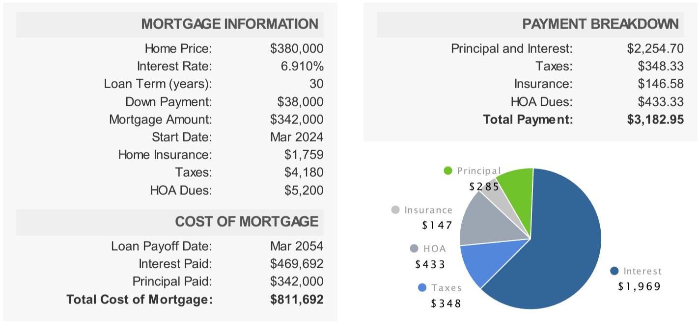
What can I afford? (Single Income Household)
https://www.mortgagenewsdaily.com/mortgage-calculator

Slide 4
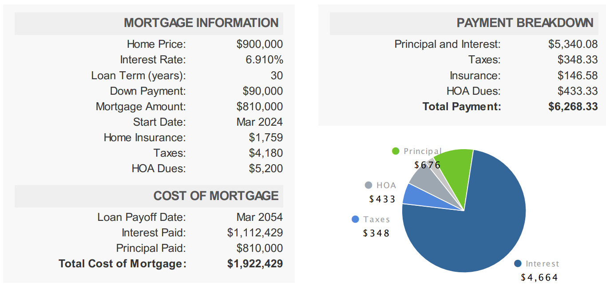
What can I afford? (Dual Income Household)
https://www.mortgagenewsdaily.com/mortgage-calculator

Slide 5
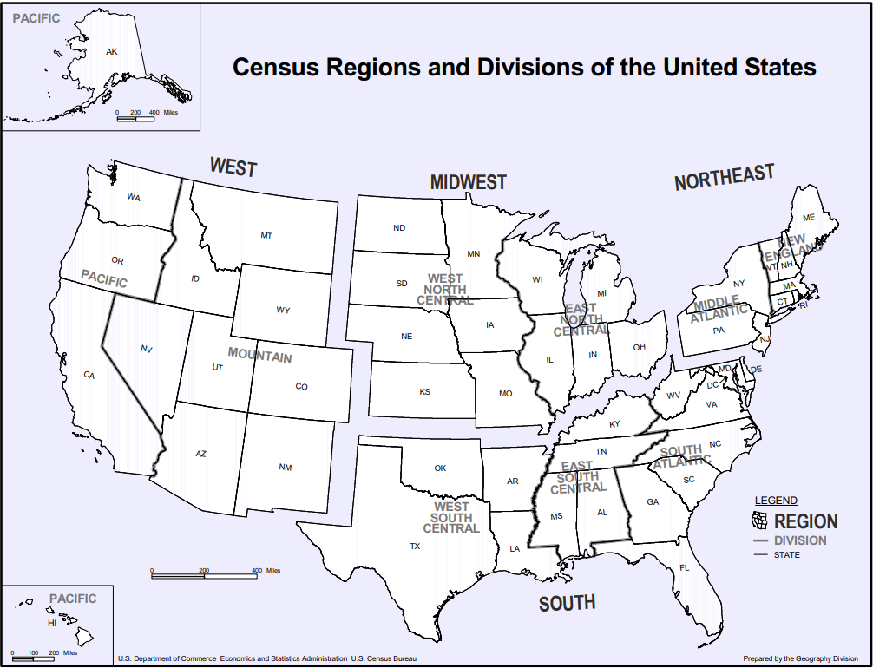
Our dataset
Zillow Home Value Index categorized based on Metropolitan Statistical Area (MSA)
1 Bedroom
2 Bedroom
3 Bedroom
Geographical Regions and Divisions of the MSAs from US Census
Total of 14.2MB

Slide 6
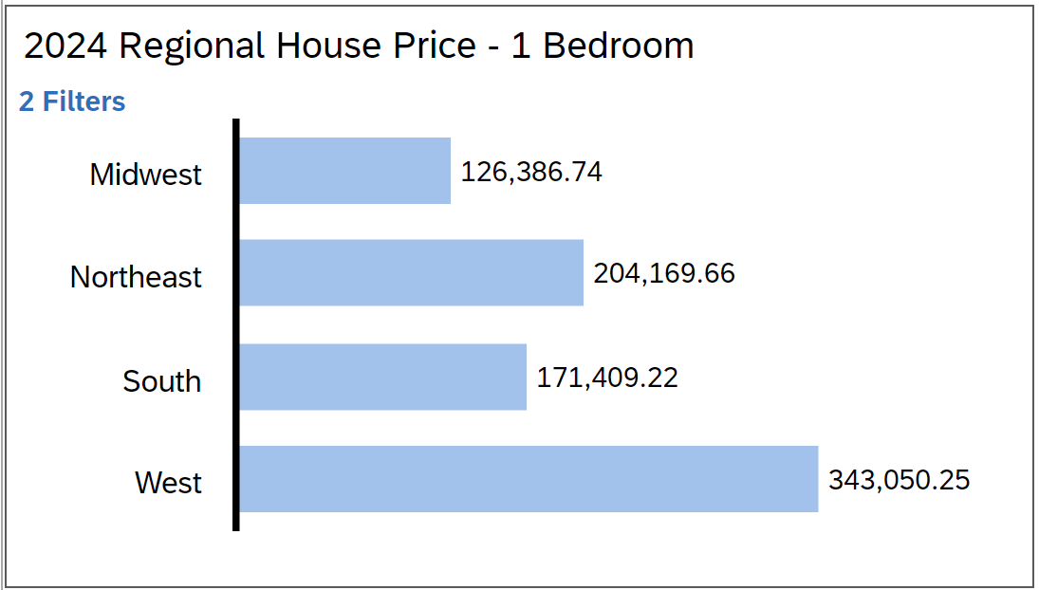
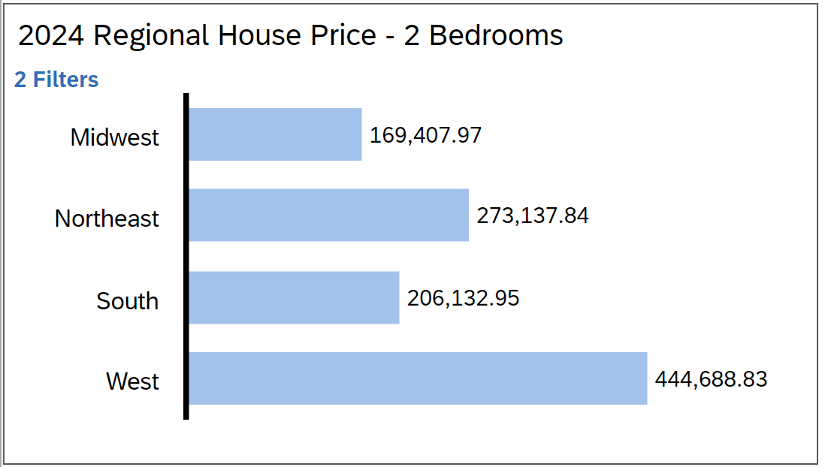
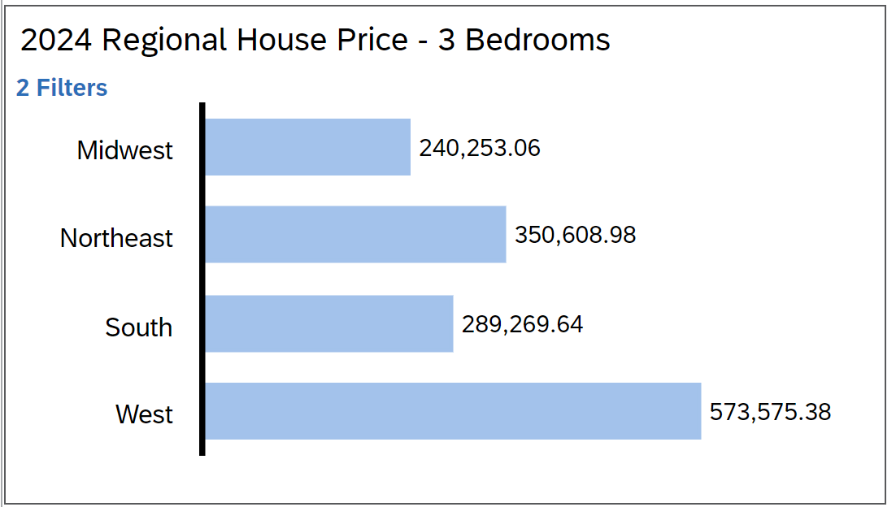
2024 Regional House Prices

Slide 7
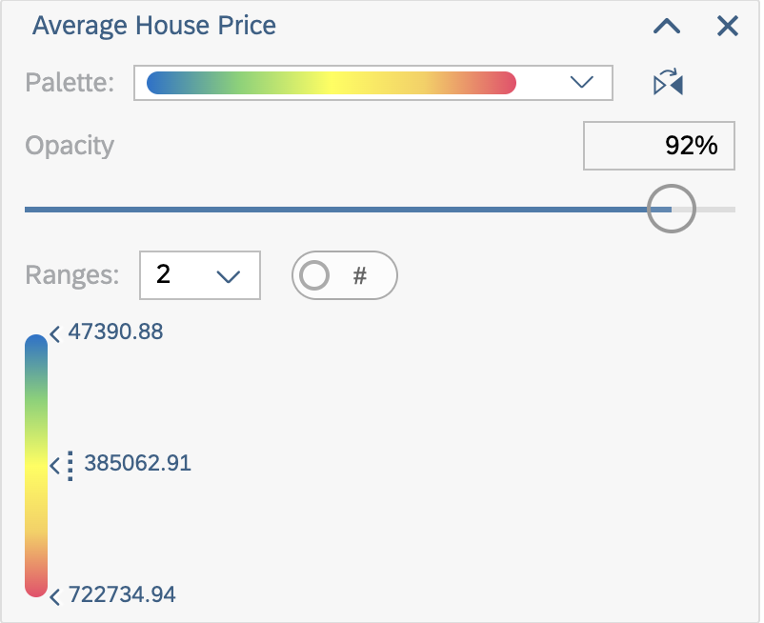
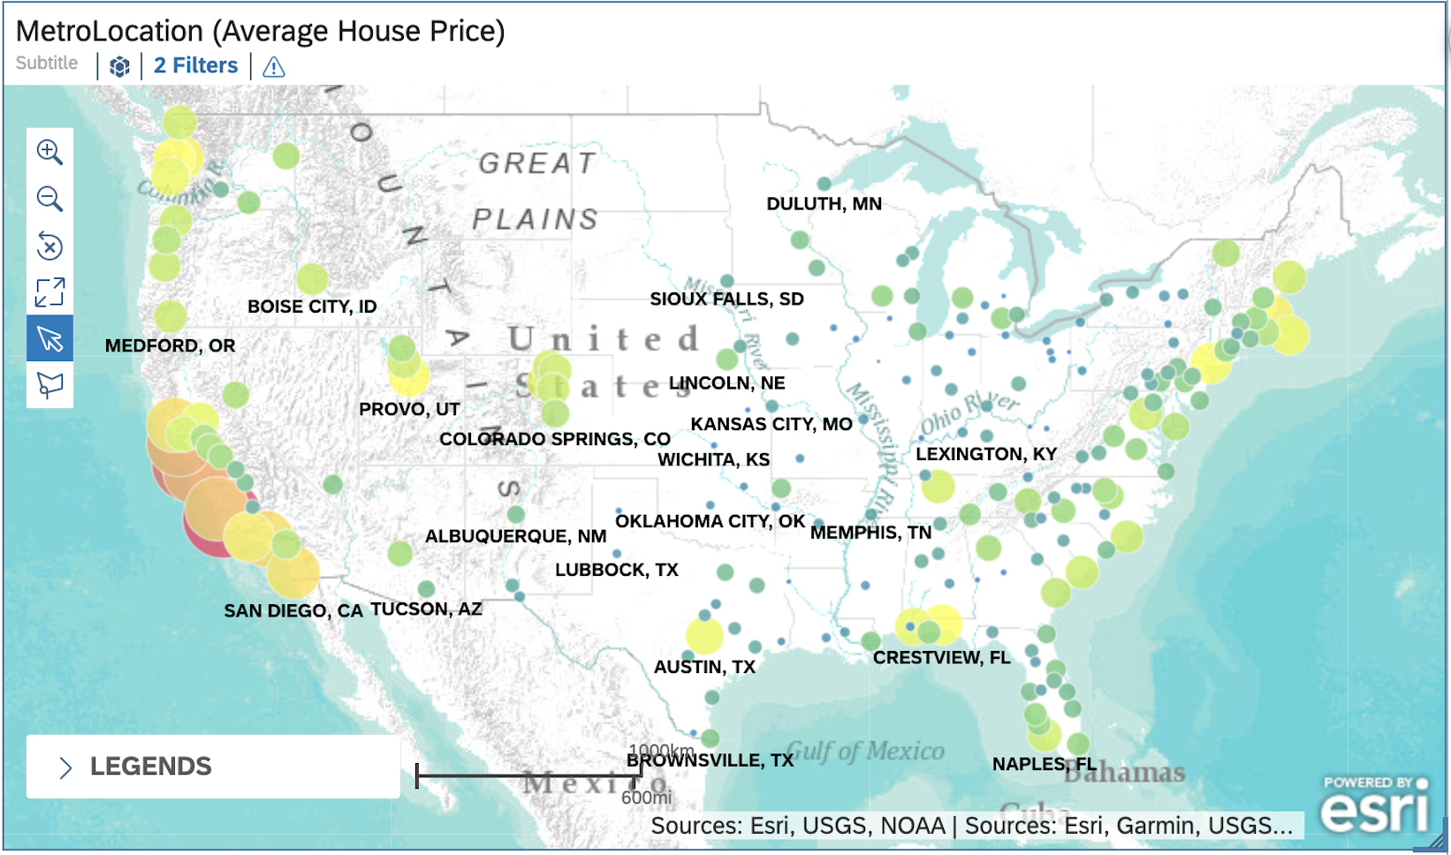
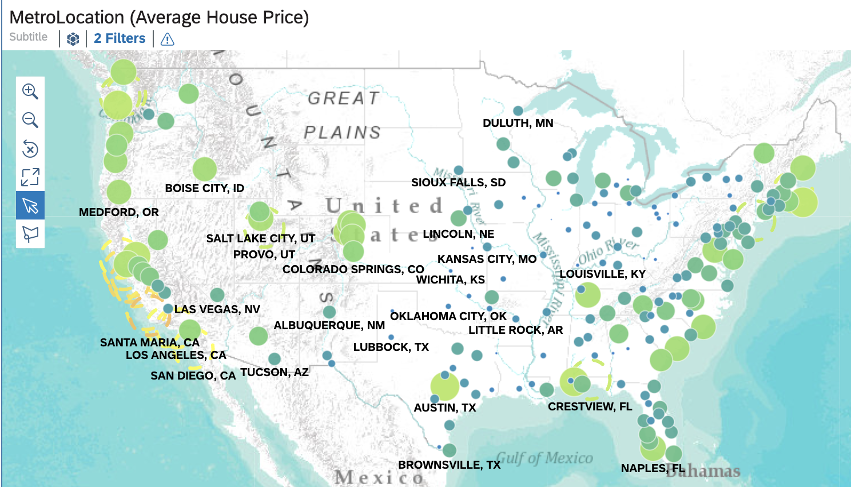
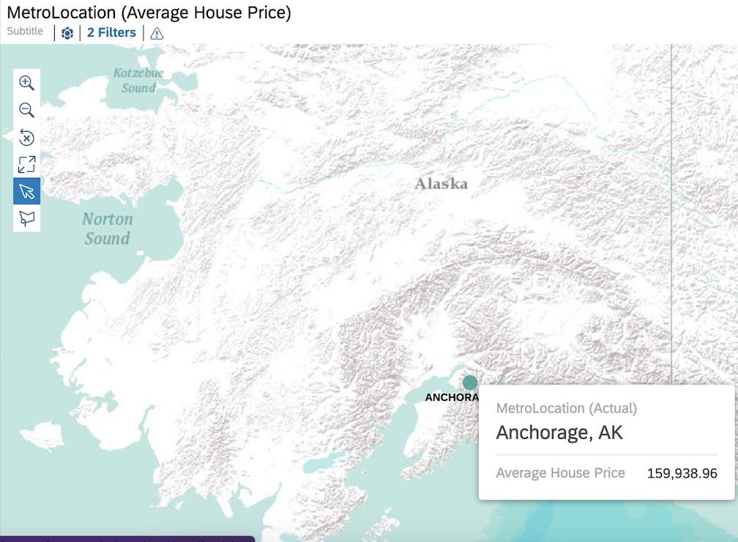
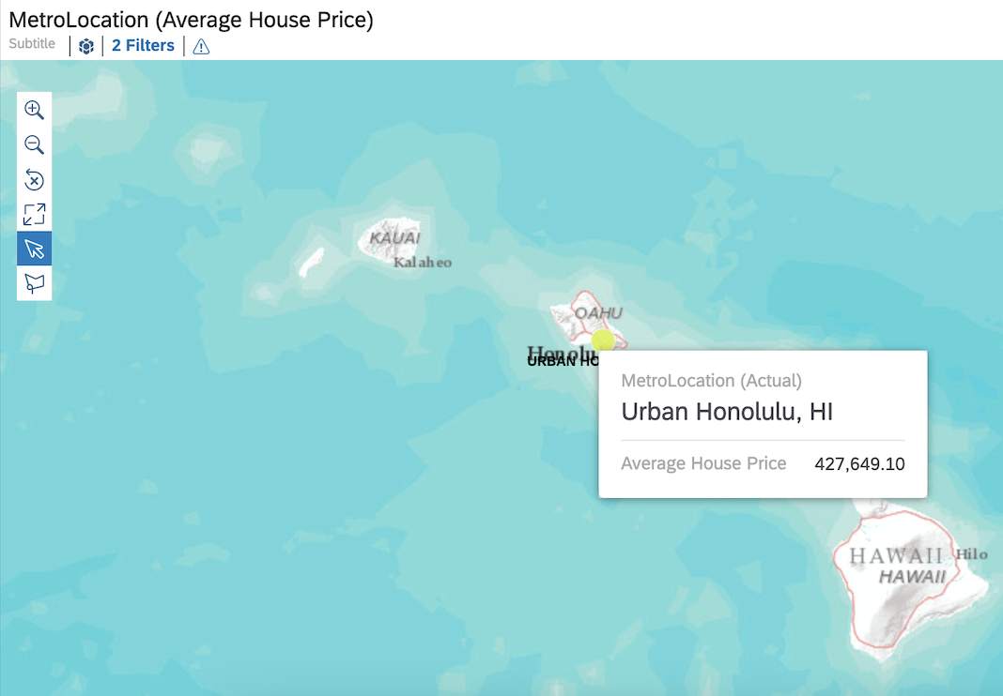
SARAH: 1 Bedroom $380,000.00

Slide 8
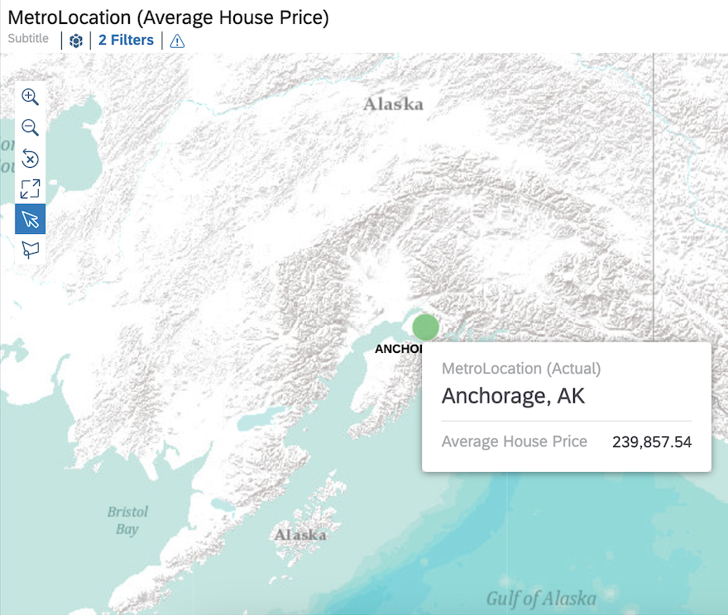
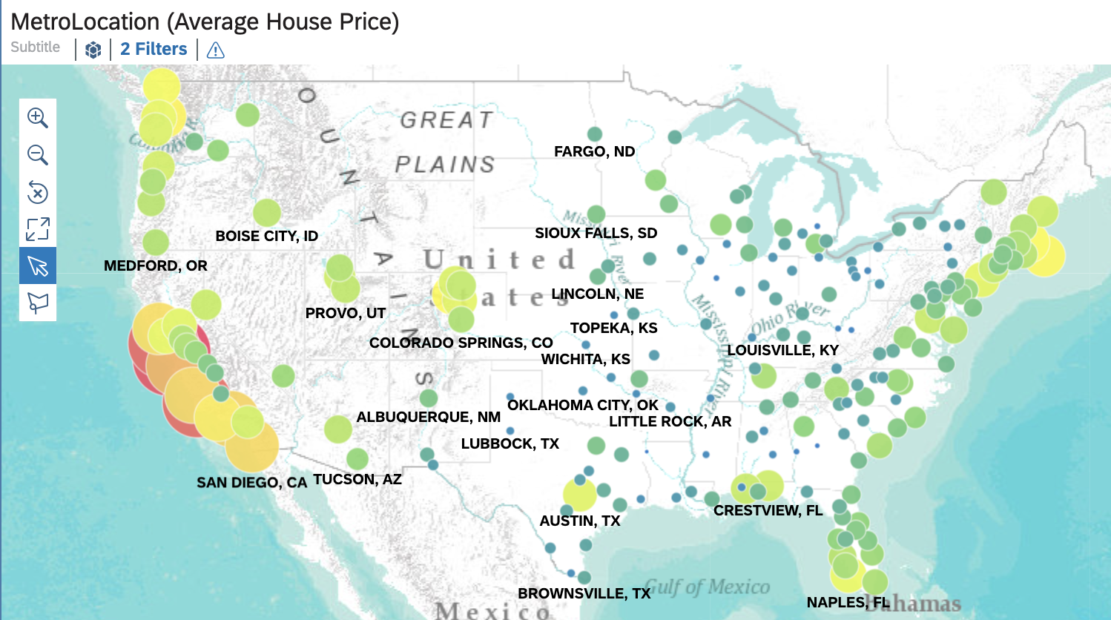
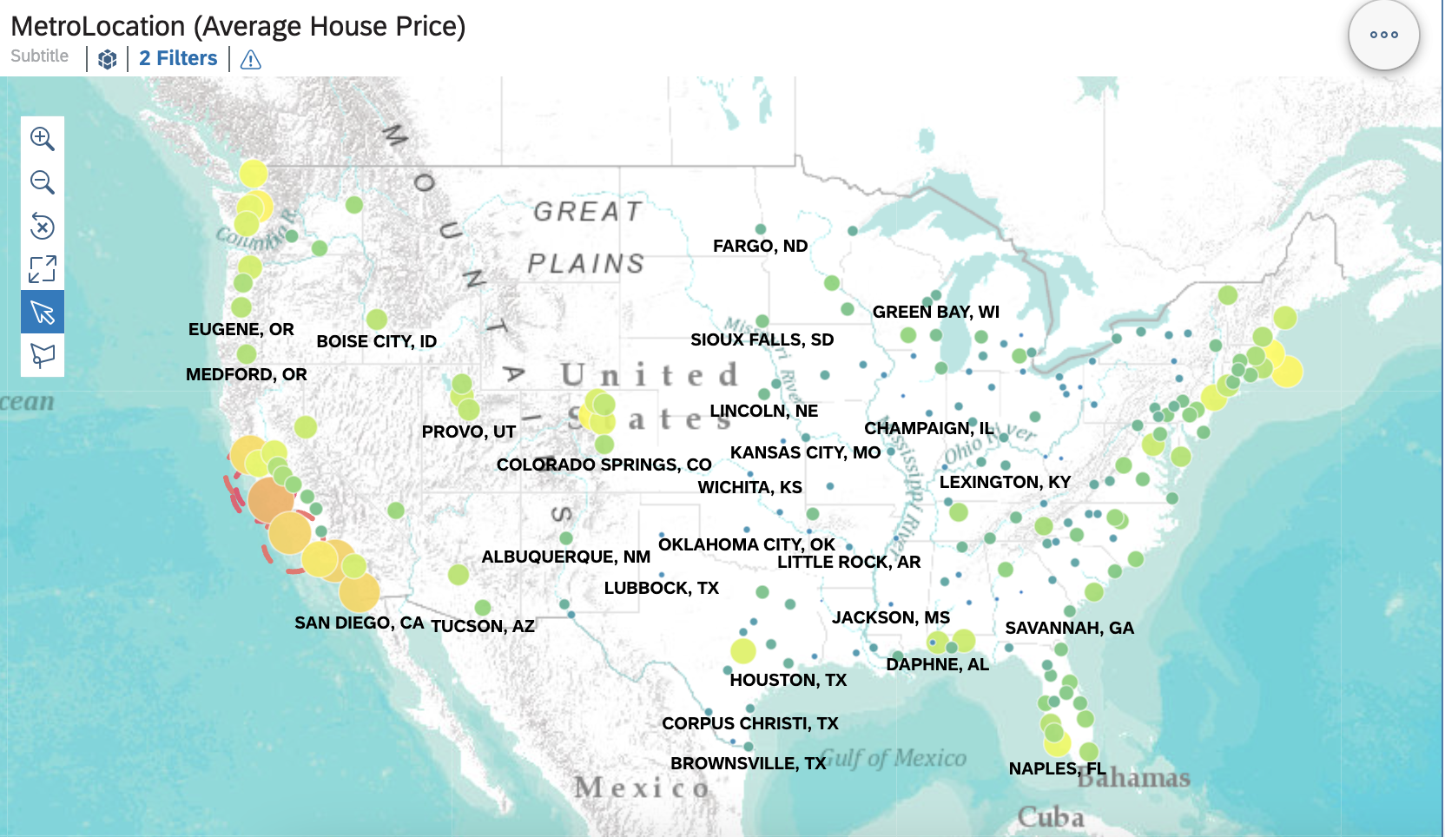
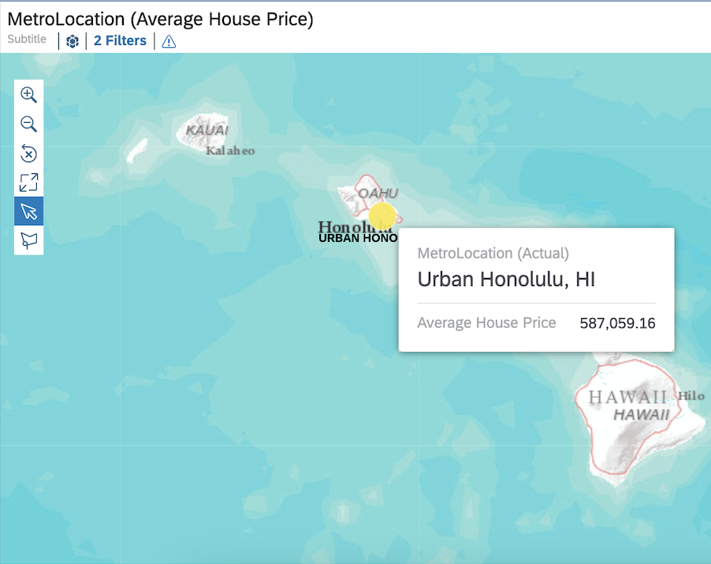
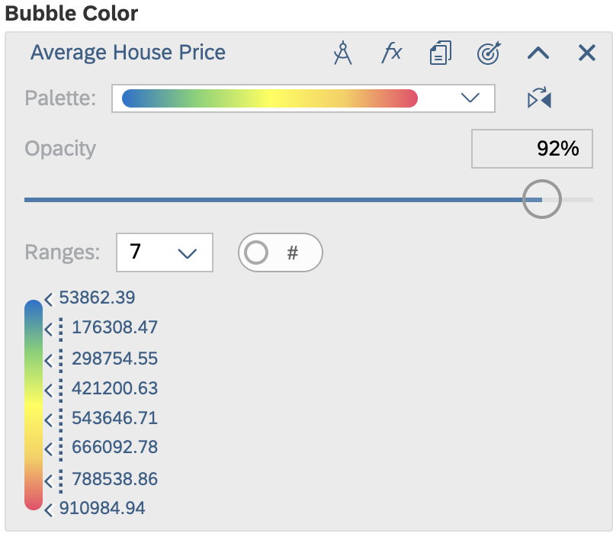
Joe & Sasha: 2 Bedroom $900,000.00

Slide 9
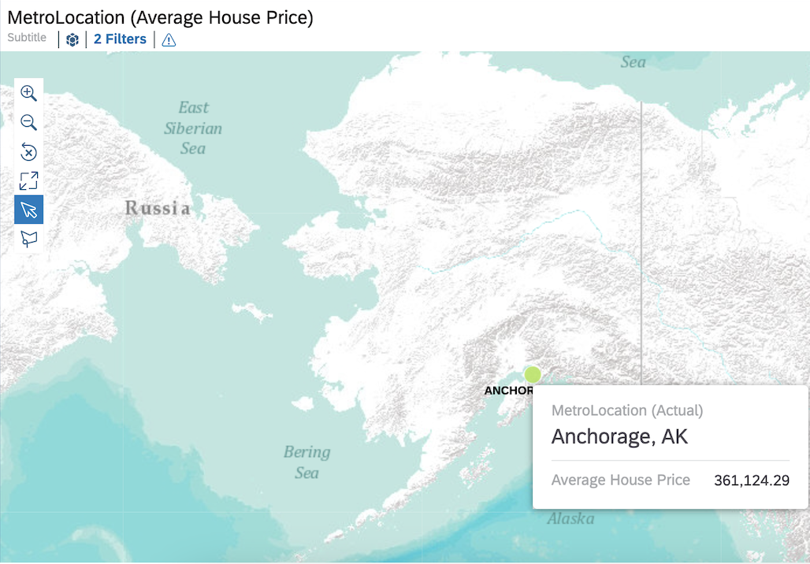
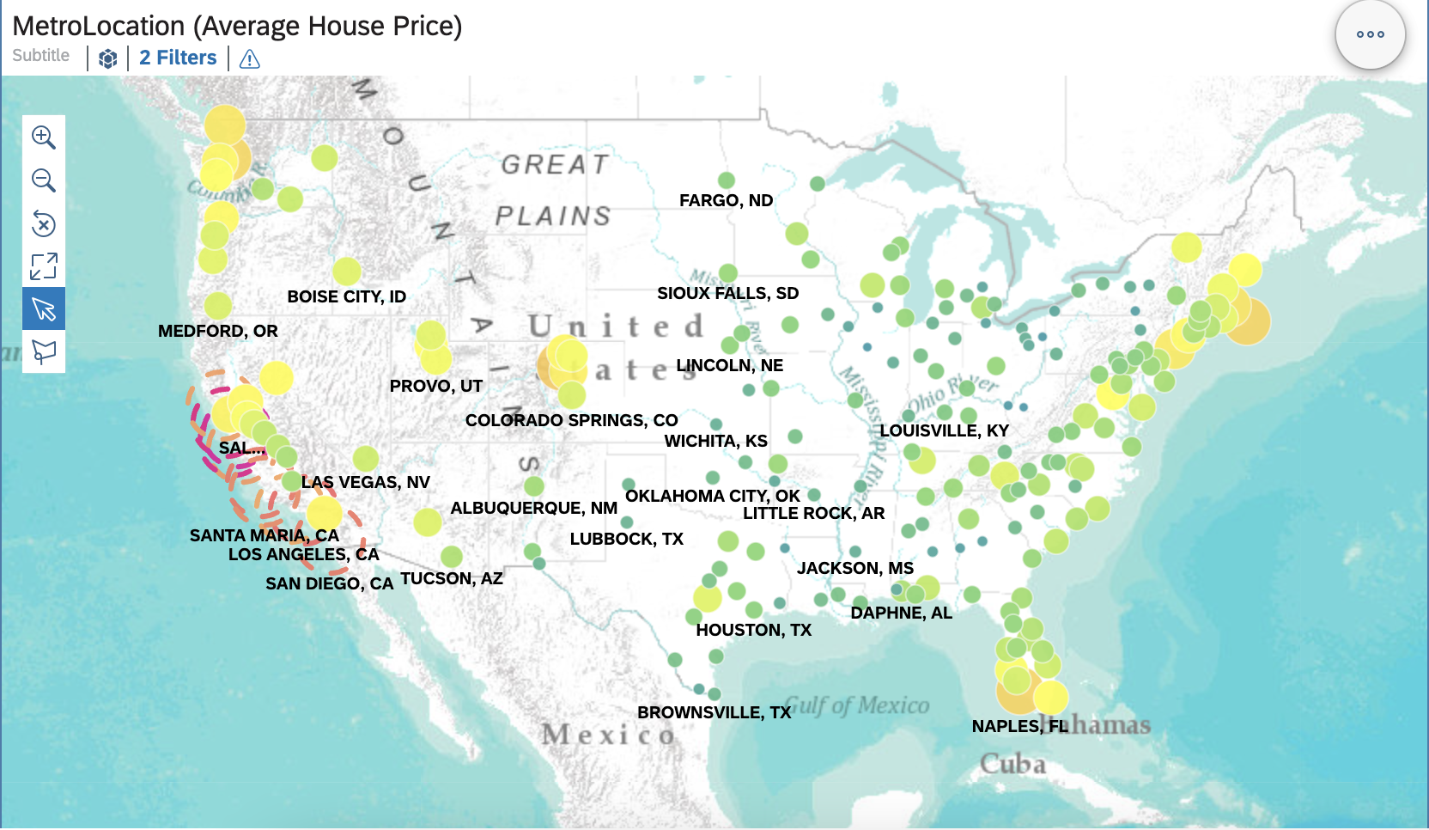
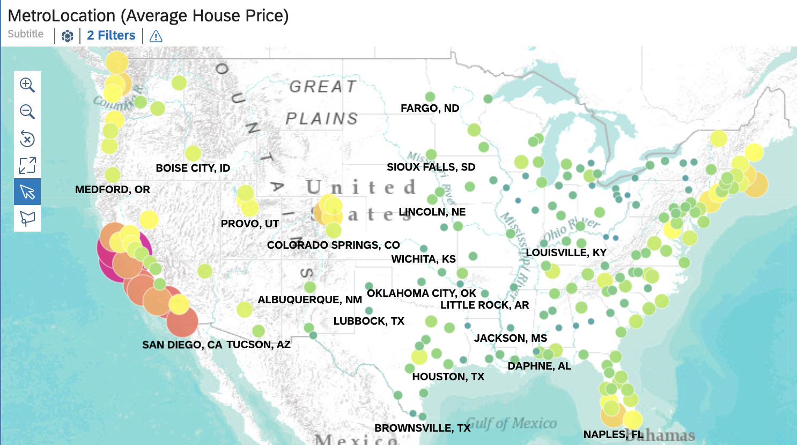
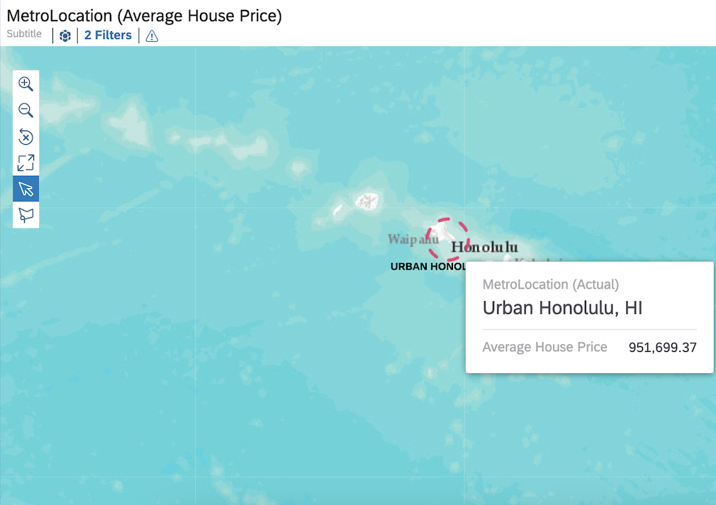
Raj, Deepa, and Rita 3 Bedroom $900,000

Slide 10
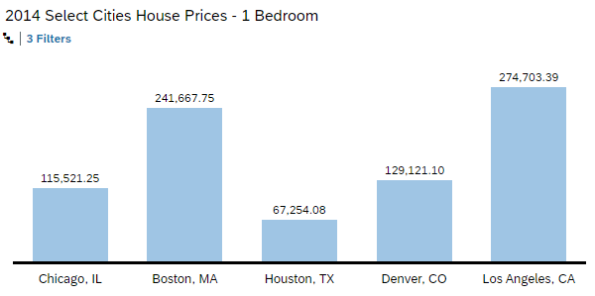
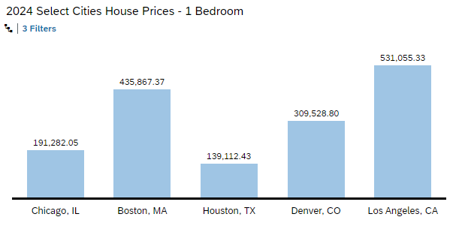
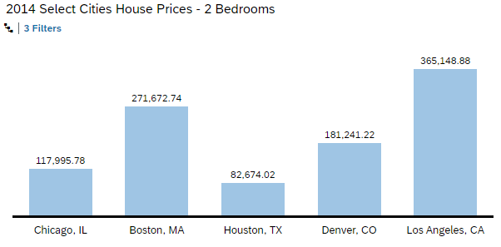
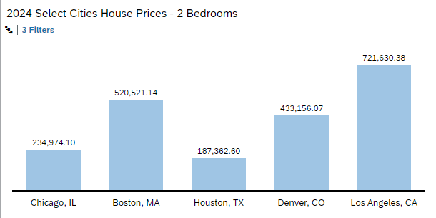
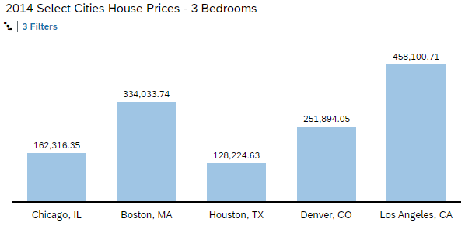
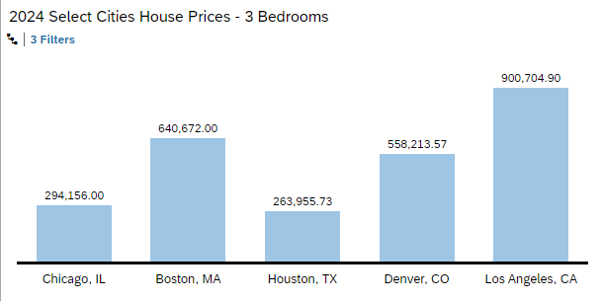
CITY | DIFF $ | DIFF %
Chicago | $75,760.80 | 65.6%
Boston | $194,199.62 | 80.4%
Houston | $71,858.35 | 106.8%
Denver | $180,407.70 | 139.7%
LA | $256,351.94 | 93.3%
CITY | DIFF $ | DIFF %
Chicago | $116,978.32 | 99.1%
Boston | $248,848.40 | 91.6%
Houston | $104,688.58 | 126.6%
Denver | $251,914.85 | 139.0%
LA | $356,481.50 | 97.6%
CITY | DIFF $ | DIFF %
Chicago | $131,848.65 | 81.2%
Boston | $306,638.26 | 91.8%
Houston | $135,731.10 | 105.9%
Denver | $306,319.52 | 121.6%
LA | $442,604.19 | 96.6%

Slide 11
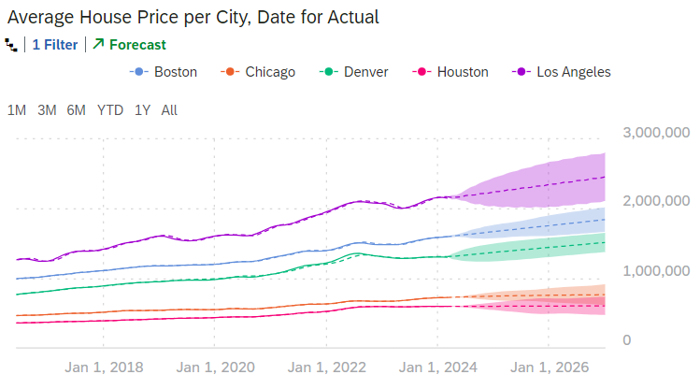
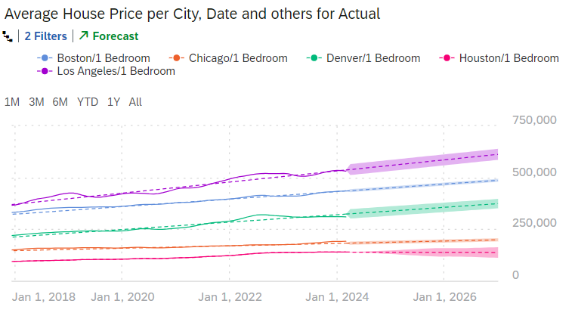
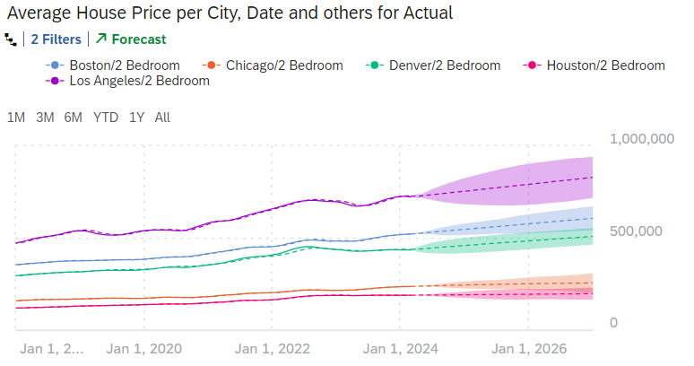
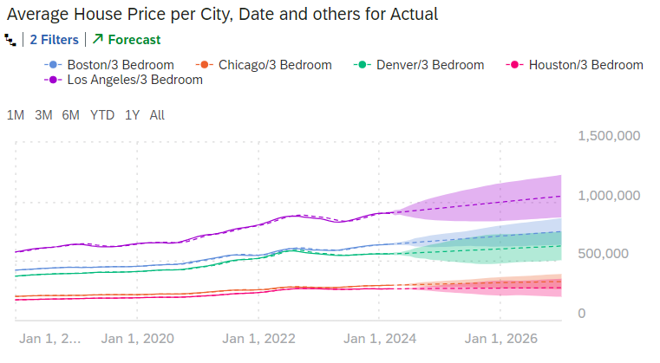
Timeseries Analysis

Slide 12
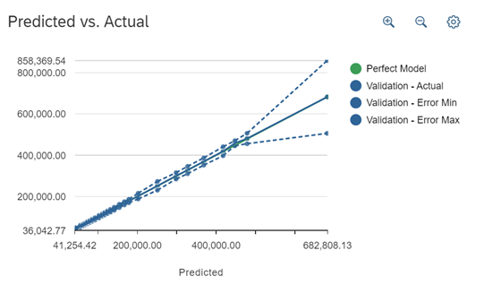
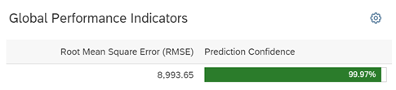
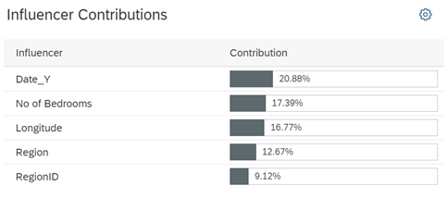

Regression analysis
High Prediction Confidence at 99.7%
Low RMSE at 8,993.65 (in dollars)
At Predicted Value of 681,983.14:
Validation – Error Min: 505,874.21
Validation – Error Max: 858,396.54
Min/Max Range of +/- 25.8%
Validation – Actual (Perfect Model) 682,121.87 (difference from the Predicted Value of 138.73)
Predictive Model CONFIRMED as accurate to predict House Price

Slide 13

conclusion
Real Estate Dataset offered broad options
Narrowed to focus on affordability of homes in five key cities across the US
Data wrangling is critical for functionality of SAC
Data revealed major variances in housing prices within the US – we uncovered that Los Angeles is NOT affordable!
We built data models, stories, time series and predictive regression model
Our dataset yielded high accuracy in the regression model, with a prediction confidence of 99.7%

Slide 14





team
ANDYMIKE
EMATA
Claudia
pEREZ De La cruz
Kelly
templeton
Kelly
young
Madeleine
dela cruz

Slide 15

Thank you!

